Slide 1
Day 4- Number Systems & Binary Numbers
Code.org – Stage 4 and 5

Slide 2
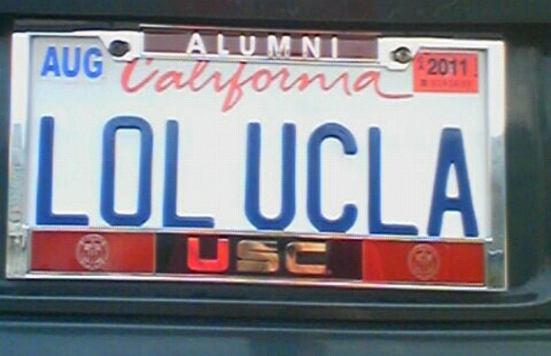
Start Day and Quiz
Quiz
Grade Quiz Together

Slide 3
Finish and Review
Review- Sending Binary Numbers
Finish Code.org Lesson 3- W/ Internet Simulator

Slide 4
Vocabulary for Today
Permutation: a way, especially one of several possible variations, in which a set or number of things can be ordered or arranged.
Number System: a collection of symbols and the rules for ordering them

Slide 5
Different Number Systems
Number Systems are defined by their number of symbols or base
Decimal (Base-10) = 0-9
Binary (Base-2) = 0 and 1
Hexadecimal (Base-16) 0-9 and A-F

Slide 6
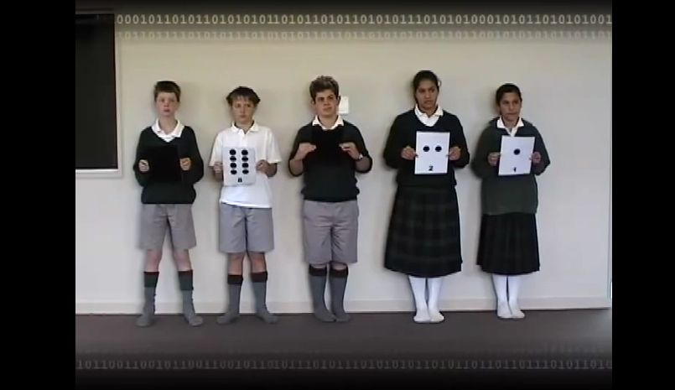
Video- Counting Binary
English Computer Science Unplugged- Binary

Slide 7
Binary Flippy Do
Flippy Do Template

Slide 8
Binary Practice
Binary Practice -Work with a Partner
Binary Game- Beat Your Partner

Slide 9
Review / Conclusion / Lessons 4 & 5
Different Number Systems
Binary Counting
Flippy Do Chart
Journal Info
Next Quiz?
Do Lessons 4 & 5 Now and/or Home

